Slide 1
Parents and Carers Evening Triple therapy
DR S Nath
6th Feb 2019

Slide 2
Content
Introduction
Classes of Mutations
Current therapies
Triple therapy
Results
Predicted schedule
Current trials

Slide 5
Cystic Fibrosis Transmembrane Regulator (CFTR) potentiators
Current market
Ivacaftor
Class III mutations (G551D)
Approved for use age >2 years in uk
Promotes CFTR channel opening
Reduction sweat chloride
Improvement in FEV₁ by 10% after 48 weeks
Weight increase
https://www.kalydeco.com/study-results

Slide 6
Trivedi B, Doorway to a Cure, Discover, 30 Jul 2013

Slide 7
CFTR correctors
Orkambi
symdeko
ivacaftor + Lumicaftor
Class II mutations (DF 508)
Not currently approved by NICE
Reduces sweat chloride
Slows decline in Lung Function by 42%
Improved Lung clearance Index
Increase in lung function by 4%
Approx £100,000 per patient per year
Ivacaftor + Tezacaftor
Class II mutations
Currently used in US
Similar efficacy to orkambi
>11 years of age
Reduces pulmonary exacerbations by 35%
Better tolerated than orkambi
https://www.orkambi.com/results-with-orkambi
https://www.symdeko.com/study-1-results

Slide 8
Triple Therapy – What is it?
Ivacaftor + Tezacaftor + “3rd compound” (next generation corrector)
VX 445
VX 659
Class II mutations
DF 508 homozygous
DF 508 + Minimal Functioning mutation (MFM)
Potential to target 90% of patients

Slide 9
https://mstrials.org.au/what-are-clinical-trials

Slide 10
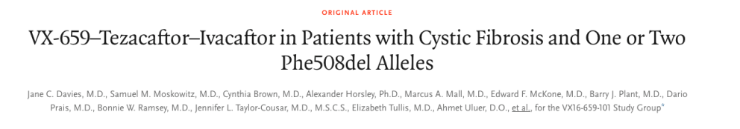
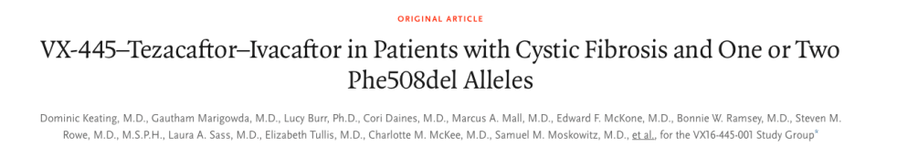

Slide 11

Patients >17yrs age from 48 sites
Dual therapy for 4 weeks then…
Triple therapy for 4 weeks
Dual and placebo for 4 weeks
Followed up for 28 days
Results
DF 508 / DF 508 increase in FEV₁ (lung function) by 10%
DF F508 / MFM Increase in FEV₁ (lung function) by 14%
Safety good and supports potential submission for new drug

Slide 12

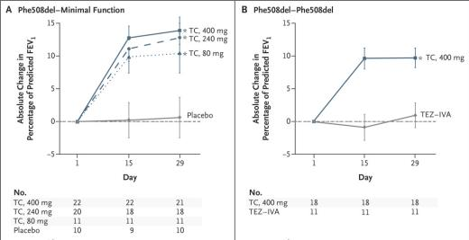
Phase 2 results
Patients >17yrs age over 38 centres
Treated 4 weeks with medication or placebo
Results
DF 508 / DF 508 increase in FEV₁ (lung function) by 11%
DF F508 / MFM Increase in FEV₁ (lung function) by 13.8%

Slide 13
What lies ahead…
Patient enrolment complete for Phase 3 trials
Possible new drug application mid 2019 in US
Late 2019 for regulatory submission outside of US
Additional safety and efficacy data late 2019
Launch of triplet ?2020
Lopes, Triple Combo with VX-659 Improves Lung Function in CF Patients with F508del Mutation, Cystic Fibrosis News. Nov 2018

Slide 14
current trials
START
ALPINE 2

Slide 15
The cystic fibrosis (CF) anti-staphylococcal antibiotic prophylaxis trial (CF START)
http://www.cfstart.org.uk
Randomised trial to assess safety and efficacy of longterm flucloxacillin prophylaxis
Conflict of practice across globe
Prevent and treat vs detect and treat
prevention of staph vs risk of pseudomonas
new cf diagnosis
Recruitment Until jan 2020
F/U for 4 years

Slide 16
Aztreonam Lysine for Pseudomonas Infection Eradication (ALPINE)2
ALPINE
nebulised aztreonem 75mg tds for first pseudomonas
Treatment was effective and well tolerated
Randomised, double blind study
Age 3 months to 17 years
First isolation pseudomonas
28 days vs 14 days + 14 days placebo
Recruiting until June 2021
https://clinicaltrials.gov/ct2/show/NCT03219164

Slide 17
Discussion

